Slide 1
Gesture Controlled Mouse and Voice Assistant

Slide 2
The Team
Presenters
Deepanshu (1900270120019)
Devansh (1900270120020)
Harsh (1900270120025)
Jigyansh (1900270120033)
Mentor : Ms. Harnit Saini

Slide 3
Why it is needed
Accessibility
Gesture-controlled mice can enhance accessibility for individuals with physical disabilities or limitations that make it difficult to use a traditional mouse or keyboard.
Natural and Intuitive Interaction
Gestures are a natural and intuitive way for humans to interact with the physical world. By translating hand or body movements into computer commands, gesture-controlled mice provide a more natural and immersive user experience. This can be particularly useful in applications such as virtual reality (VR) or augmented reality (AR), where traditional input methods may be cumbersome.
Ergonomics
Traditional mouse usage over extended periods can lead to repetitive strain injuries (RSIs) or discomfort. Gesture-controlled mice offer an alternative input method that reduces strain on the hands and wrists, potentially minimizing the risk of developing these issues.
Hygiene and Contactless Interaction:
In situations where maintaining hygiene or avoiding contact is crucial, such as in healthcare settings or public spaces, gesture-controlled mice eliminate the need for physical contact with input devices. This can help reduce the spread of germs and increase overall cleanliness.
More info on how to use this template at www.slidescarnival.com/help-use-presentation-template
This template is free to use under Creative Commons Attribution license. You can keep the Credits slide or mention SlidesCarnival and other resources used in a slide footer.

Slide 4
ABSTRACT
This project takes forward the approach of the Human Computer Interaction (HCI) by controlling cursor movement through hand movement and voice commands using a real-time camera and microphone.
Virtual mouse acts as a contactless mouse, thus can be more useful and time saving.
Specially abled people with some problem in their hands can use this virtual mouse to control the mouse functions in the computer.
Can be used for distance controlling of systems in robots, classrooms, war ammu-nations, AR and VR game, etc.
4

Slide 5
OBJECTIVE
Design for operation of a mouse with the help of a webcam which is responsible for capturing the video in real-time.
Convert hand gesture/motion into mouse function and the cursor is set to a particular screen position. The Virtual Mouse application is programmed to detect the position of fingertips and knuckles where it will be set as the position of the mouse pointers.
Develop a multi user independent speech recognition system that captures voice in real-time with the help of a microphone and is able to retrieve folders, sub-folders, documents, copy, paste, left click, right click and double click by taking voice command and checking its validity.
5

Slide 6
FEATURES

Slide 7
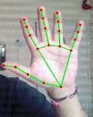
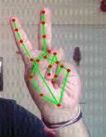
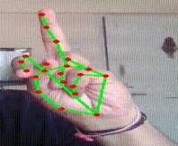
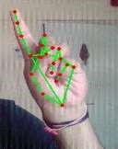
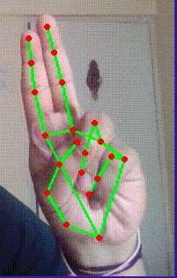
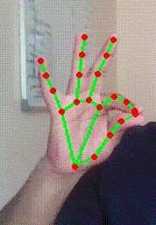
Gesture Controlled Mouse Functionalities
Neutral
Move Cursor
Left Click
Scroll / Volume & Brightness Control
Right Click
Double Click

Slide 8
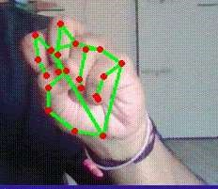

Drag and Drop / Multiple Items Selection

Slide 9
Voice Assistant Functionalities
The operations that are currently being included :
a) Google Search
b) Find a location on the map
c) File Navigation
d) Current Date and Time
e) Copy and Paste
f) Sleep / Wakeup Application
g) Exit

Slide 10
METHODOLOGY

Slide 11
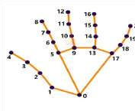
Gesture Controlled Mouse
Computer Vision technology is applied for Object identification and object video capturing in BGR format which is done by OpenCV.
Captured hand object processed by MediaPipe using two models.
a). Palm Detection Model
b). Hand Landmark Model
MediaPipe renders 21 coordinates located on a detected hand in a 2.5D space as an output.
Subsequently ids are assigned to each finger of the right hand in the rendered output landmark.
Corresponding coordinated of all the required ids are calculated and different operations are performed based on the distances and angles between the points

Slide 12
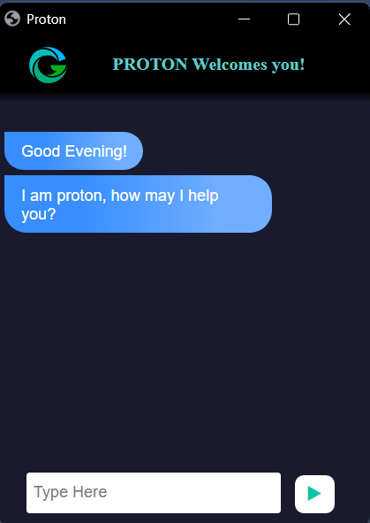
Voice Assistant
Launch Jerry on your monitor (Jerry - name of our voice assistant) .
Give command to be followed.
Speech recognition library detects your speech and jerry will perform the operations as given in the next slide.

Slide 13
FLOWCHART

Slide 14
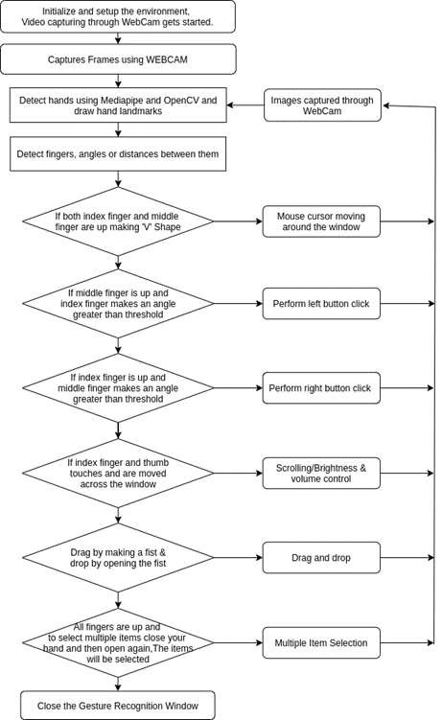
Flowchart of Gesture Controlled Mouse

Slide 15
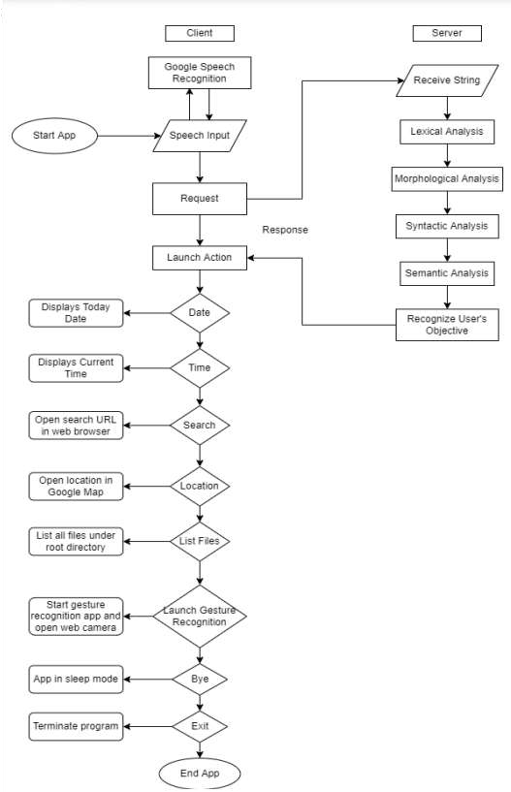
Flowchart of Voice Assistant

Slide 16
CONCLUSION
In conclusion, the project has successfully achieved its objectives of developing a robust gesture recognition algorithm and implementing a virtual mouse system controlled by hand gestures.
The project has resulted in the creation of a functional and intuitive system that allows users to control the computer mouse cursor using hand gestures. By utilizing machine learning or deep learning techniques, the gesture recognition algorithm demonstrates high accuracy in interpreting and classifying hand gestures in real-time.
The future of voice assistant projects holds immense potential for transforming our daily lives and reshaping the way we interact with technology. The advancements in natural language processing, artificial intelligence, and voice recognition technologies will pave the way for voice assistants to become more personalized, intelligent, and contextually aware.
4

Slide 17
THANKS!

